Slide 1
Predicting Bean Type Based on Metamorphic Measurements
Analysis by Gavin Gunawardena
Utilizing a dataset from Seed Size and Shape Analysis of Registered Common Bean (Phaseolus vulgaris L.) Cultivars in Turkey Using Digital Photography from the Journal of Agricultural Science

Slide 2
Intro and Objective
Objective: Test various predictive analytics algorithms for multiclass classification to sort beans based on their morphometric measurements
Dataset
3000 observations
500 observations per class
6 classes
No additional assumptions
Measures
Accuracy
Weight differential between predictions and actual values
Cost differential between predictions and actual values

Slide 3
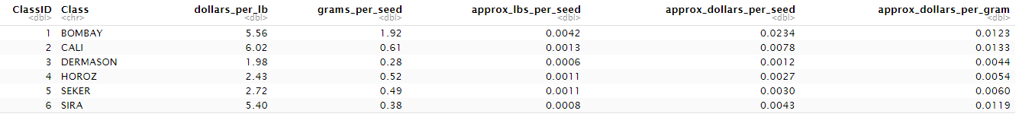
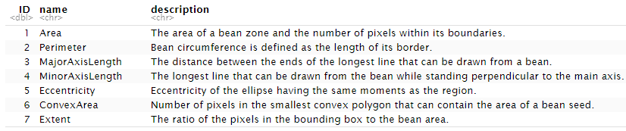
Intro and Objective
Dependent Variable Classes:
Independent Variables:

Slide 4
Methods
Validation Technique
Leave One Out Cross-Validation
80/20 data split with 80% of the data being used for training and validation while the last 20 is used to test the final model(s) and obtain a final accuracy rate
Normalization/Standardization Technique
Z-Score
Feature Selection Method
Best Subset Selection with residual sum of squares and then adjusted R^2 as the criteria for feature selection
Statistical Models
Multinomial Logistic Regression
Linear Discriminant Analysis
K-Nearest Neighbors Classifier
Quadratic Discriminant Analysis
Naïve Bayes

Slide 5
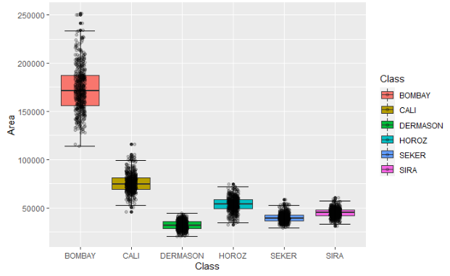
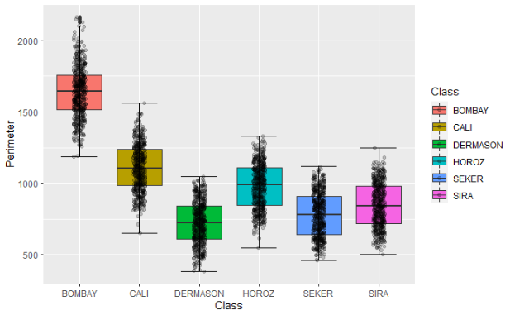
Exploratory Analysis

Slide 6
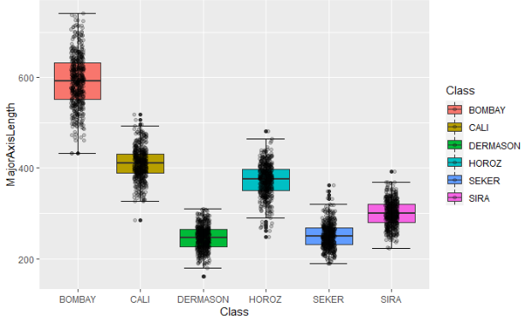
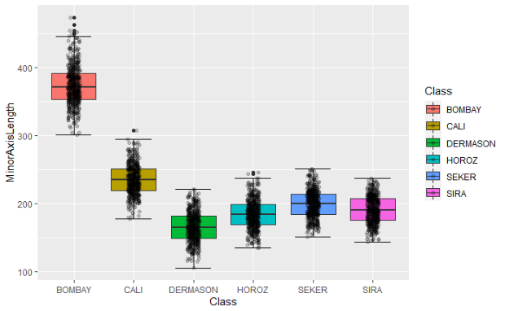
Exploratory Analysis

Slide 7
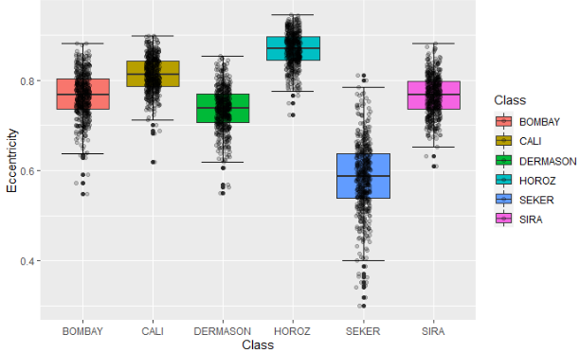
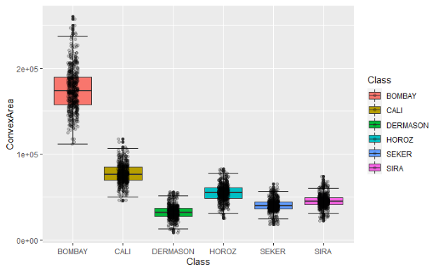
Exploratory Analysis

Slide 8
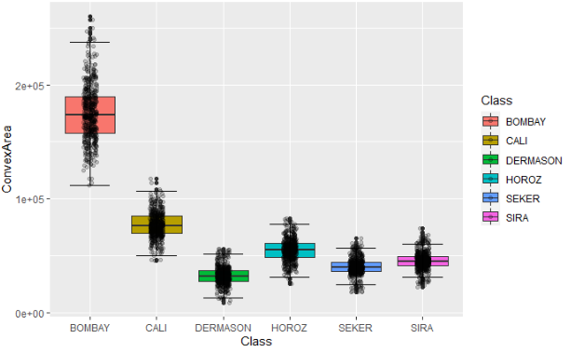
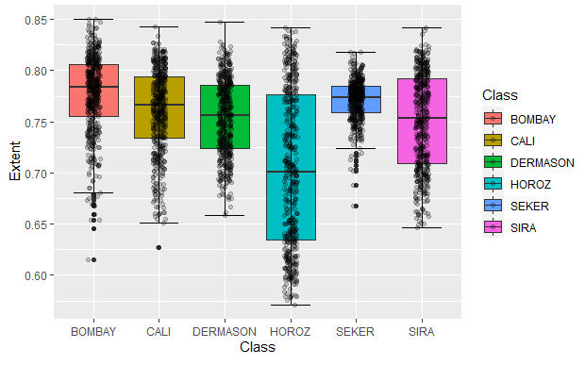
Exploratory Analysis

Slide 9
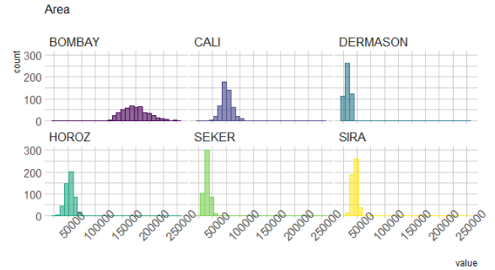
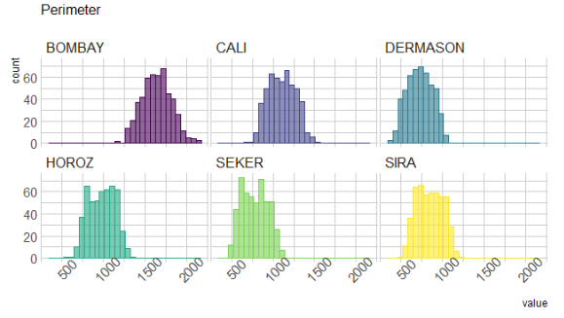
Exploratory Analysis

Slide 10
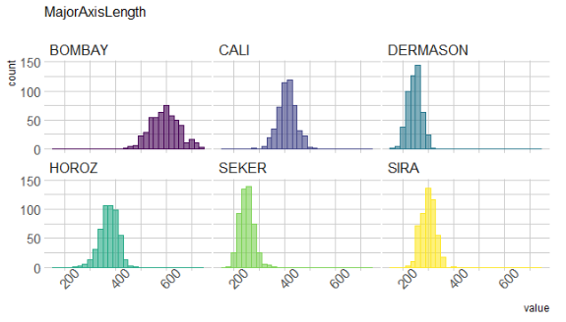
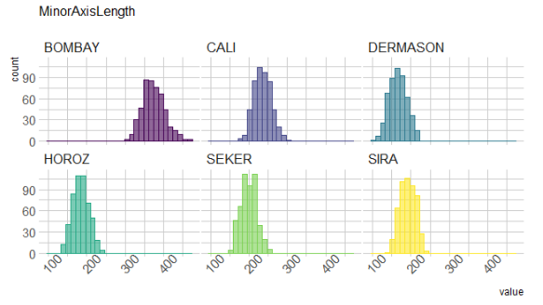
Exploratory Analysis

Slide 11
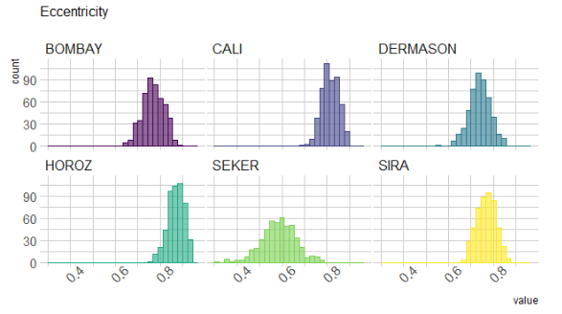
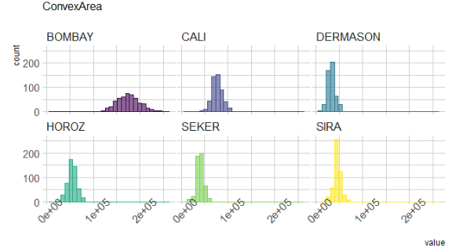
Exploratory Analysis

Slide 12
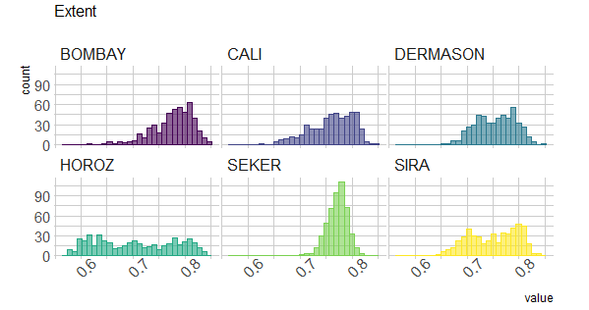
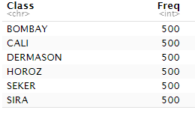
Exploratory Analysis
Results:
Most of the data is normally distributed with the least normally distributed variable being Extent
The dataset has many outliers as revealed by the boxplots. These will be removed in order optimize the predictive models.

Slide 13
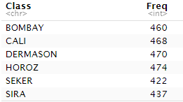
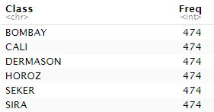
Exploratory Analysis
Results After Outlier Removal
Dataset was reduced from 3000 observations to 2731 but bolstered back to 3000 via oversampling minority datasets:

Slide 14
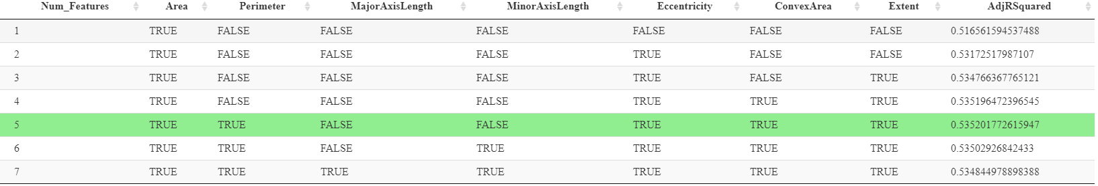
Predictive Analysis
Best Subset Selection results:
For each possible count of features, 1 thru 7, each were iteratively tested for their ability to accurately predict bean classes
The set with 5 features was chosen as it had the highest adjusted R^2 score
*This chart shows the results of Best Subset Selection. Number of features is shown on the left, with the selected features being represented by their respective names and whether they were present in the results of each test. This was completed in an attempt to maximize adjusted R^2. 5 features allowed for the optimal(maximum) result.

Slide 15
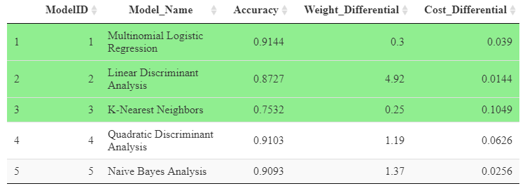
Results Analysis
Leave-One-Out Cross Validation Results and chosen models:
3 models were optimal but for different categories.
Multinomial Logistic Regression and Linear Discriminant Analysis were chosen due to their higher accuracy rates and due to having a lower cost differential, which is being prioritized over weight differential.

Slide 16
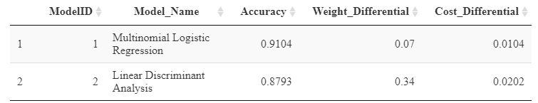
Results Analysis
Test dataset results:
The results on the test dataset indicated strong results on all three measures and by both models.

Slide 17
Conclusions
Multinomial Logistic Regression and Linear Discriminant Analysis were chosen as the most optimal when making predictions on bean types based on the morphometric measurement features
Both had accuracy rates of over 87% on the validation and test datasets, with Multinomial Logistic Regression having an accuracy rate of over 91%
Linear Discriminant Analysis had the lowest cost differential when compared to the other models

Slide 18
References
Bobbitt, Z. (2019, April 20). How to Normalize Data in R. Retrieved from Statology: https://www.statology.org/how-to-normalize-data-in-r/
Clark Science Center. (2016). Lab 8 - R. Retrieved from Clark Science Center @ Smith College: https://www.science.smith.edu/~jcrouser/SDS293/labs/lab8-r.html
James, G., Witten, D., Hastie, T., & Tibshirani, R. (2021). An Introduction to Statistical Learning with Applications in R Second Edition. Springer.
KARA, M., SAYINCI, B., ELKOCA, E., ÖZTÜRK, İ., & ÖZMEN, T. B. (2013). Seed Size and Shape Analysis of Registered Common Bean (Phaseolusvulgaris L.) Cultivars in Turkey Using Digital Photography. Journal of Agricultural Sciences, 220-221.
UCLA: Statistical Consulting Group. (n.d.). Multinomial Logistic Regression | R Data Analysis Examples. Retrieved from UCLA Advanced Research Computing: https://stats.oarc.ucla.edu/r/dae/multinomial-logistic-regression/
Xiaozhou, Y. (2020, May 9). Linear Discriminant Analysis, Explained. Retrieved from Towards Data Science: https://towardsdatascience.com/linear-discriminant-analysis-explained-f88be6c1e00b

